Slide 1
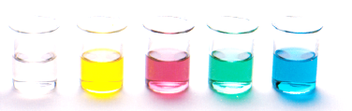
Intermolecular forces
Intramolecular vs Intermolecular – be able to define each and compare
Intermolecular forces
Dispersion forces
Dipole-dipole forces
Hydrogen bonding
Resources:
Pearson 12.3

Slide 2
Intramolecular vs Intermolecular
Intramolecular forces
These are the forces that keep atoms clusters together within molecules
Strong forces, can only be broken using chemical reactions (i.e. changing from one molecule to a different molecule)
Intermolecular forces
Forces that exist between molecules
Much weaker than Intramolecular forces

Slide 3
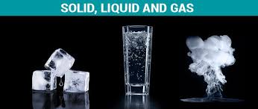
Intramolecular vs Intermolecular
In each state we have water molecules (H₂0), so what is changing to give such different properties?
Intramolecular forces stayed the same (still an oxygen atom covalently bonded to two hydrogen atoms). Forces of attraction between the molecules has changed – these are the Intermolecular forces

Slide 4
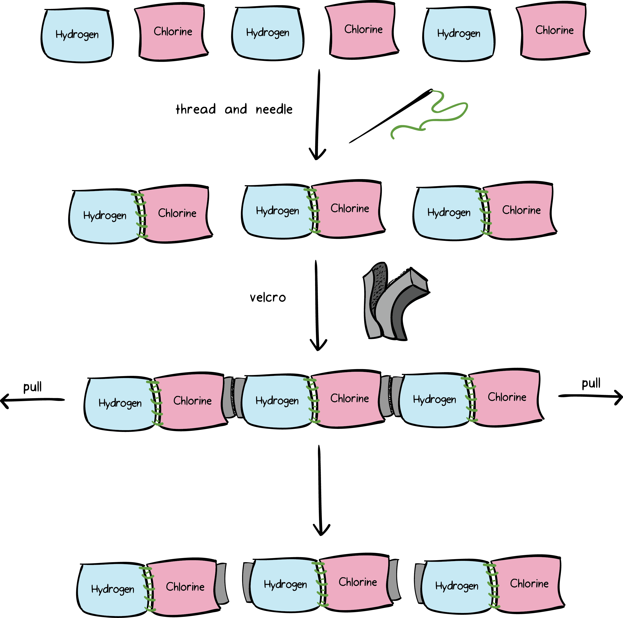
Intramolecular vs Intermolecular
Another way to think about it…
Six towels - we sew three together; then link the sets with Velcro.
Now pull…
The Velcro links break but the sewn links don’t
https://www.khanacademy.org

Slide 5
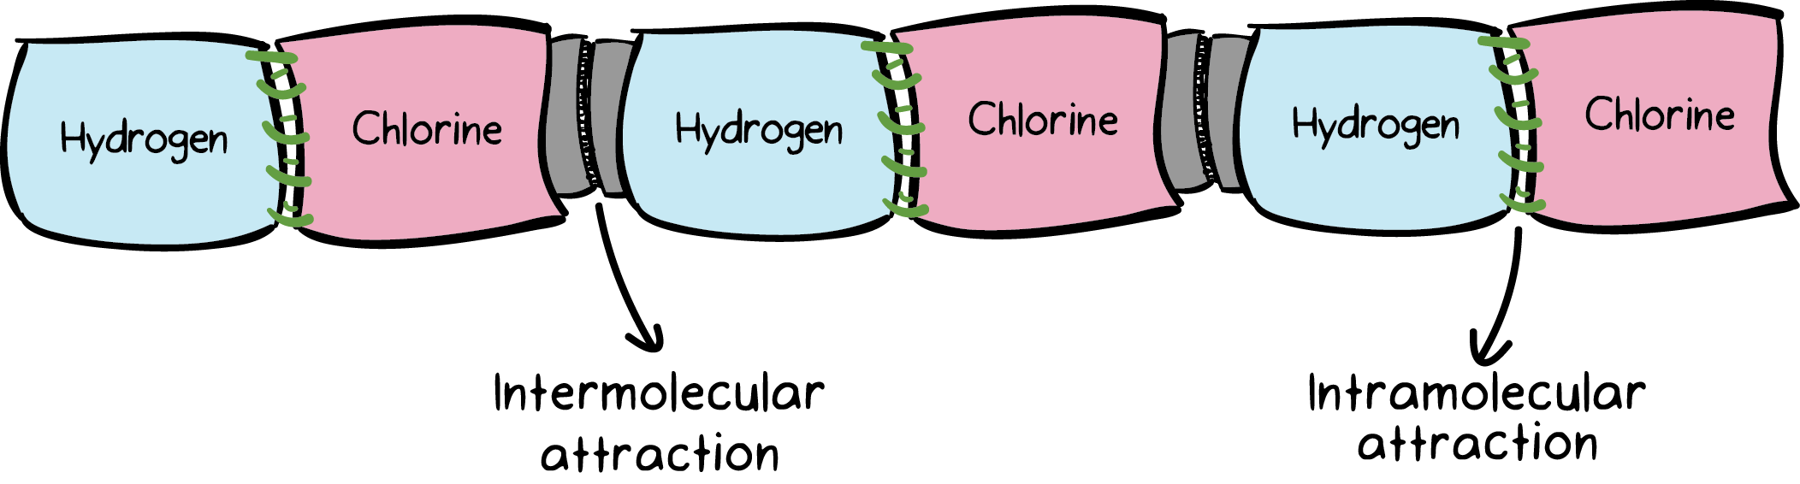
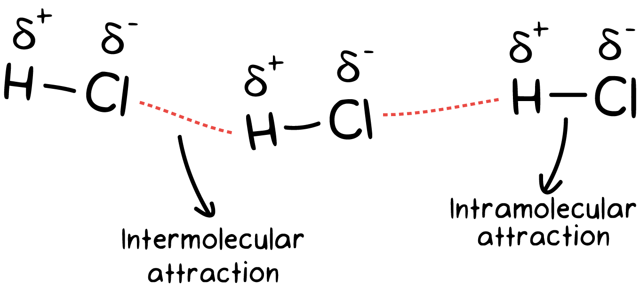
Intramolecular vs Intermolecular
Sewn links = intramolecular attraction
Velcro links – intermolecular attraction
With a small amount of energy it is possible to break the intermolecular attractions
https://www.khanacademy.org

Slide 6
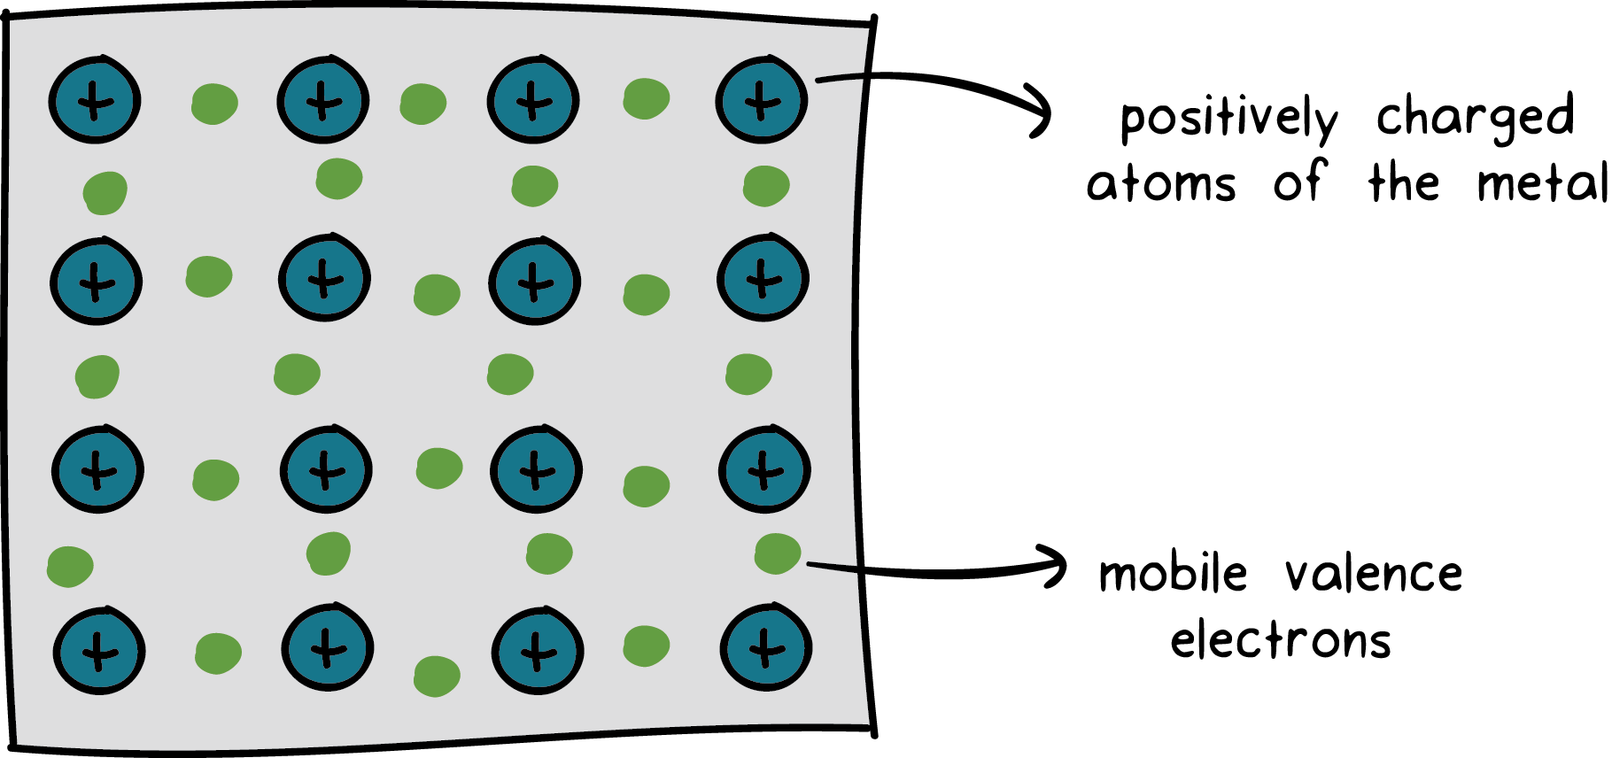
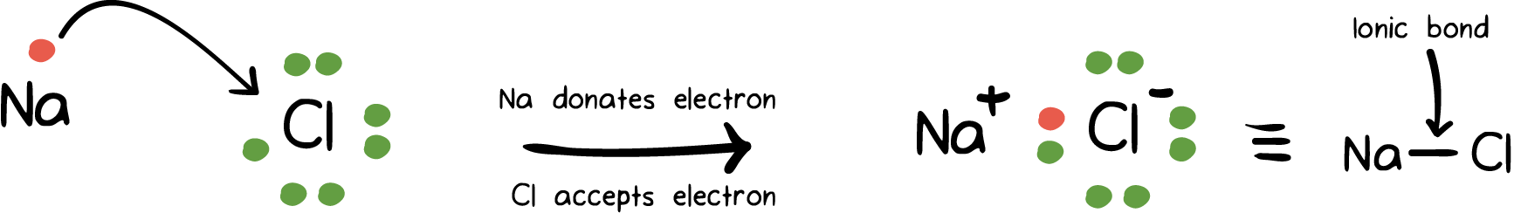
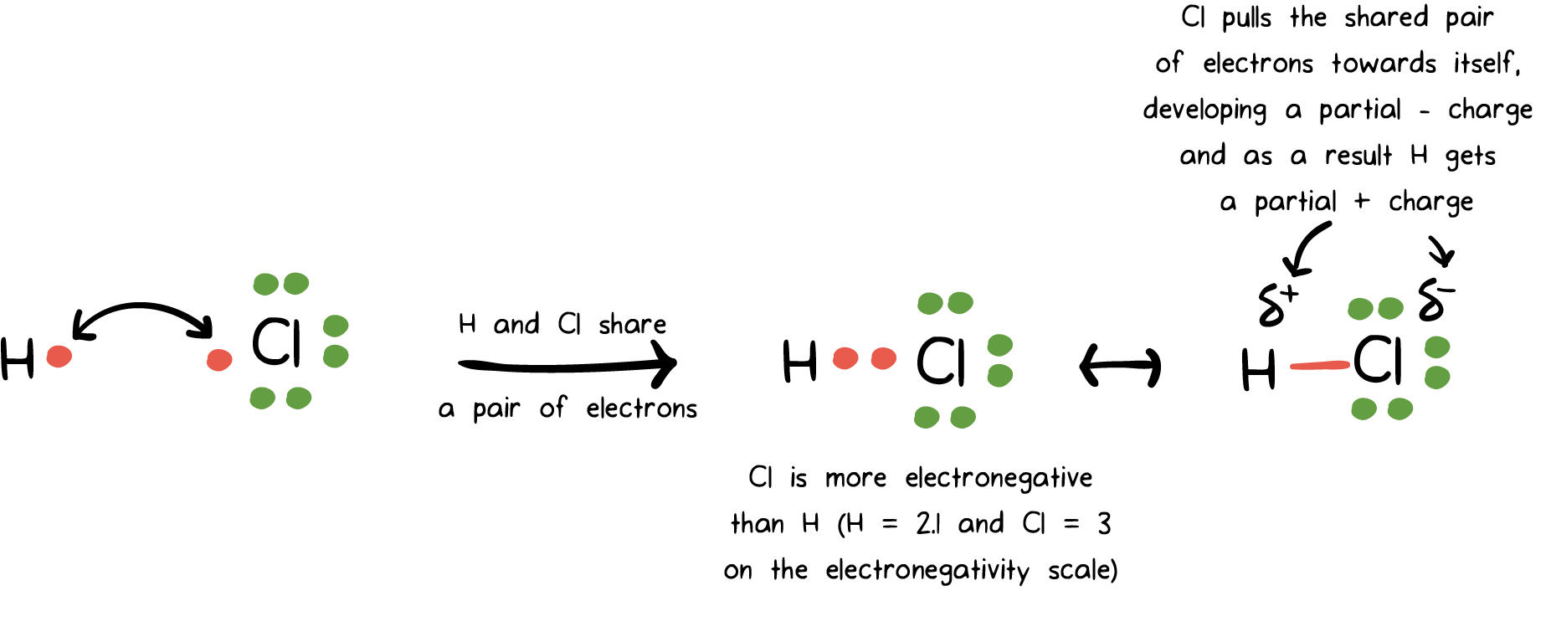
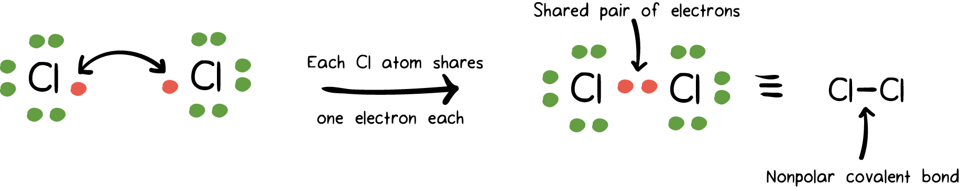
Intramolecular attraction
Ionic bonds
Metallic bonds
polar covalent
Non-polar covalent

Slide 7
Intermolecular forces
Three Intermolecular forces:
Dispersion forces (sometimes called London forces)
Dipole-Dipole forces
Hydrogen bonding
van der Waals forces
Forces of attraction between molecules, they greatly effect a substance’s physical properties (such as boiling point, melting point, solubility)

Slide 8
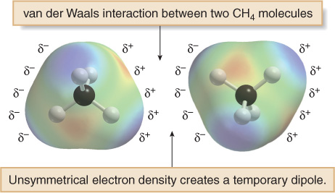
Dispersion forces
Dispersion forces are also known as London forces.
They are weak interactions caused by momentary changes in electron density in a molecule.
They are the only attractive forces present in nonpolar compounds.
Even though CH₄ has no net dipole, at any one instant its electron density may not be completely symmetrical, resulting in a temporary dipole. This can induce a temporary dipole in another molecule. The weak interaction of these temporary dipoles constitutes dispersion forces.

Slide 9
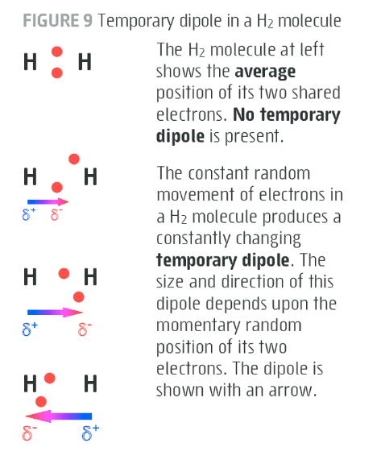
Dispersion forces
Dispersion forces arise from random motion of electrons within a molecule produce a short lived temporary dipoles
These temporarily polar molecules then cause nearby molecules to form similar temporary dipoles called induced dipoles
The molecules are then experience weak electrostatic attraction – called dispersion forces

Slide 10
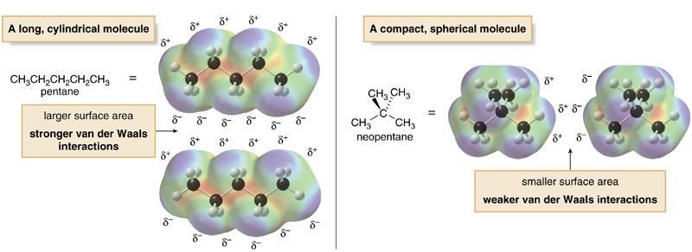
Dispersion forces
All molecules exhibit dispersion IMF
The surface area of a molecule also determines the strength of the dispersion force. The larger the contact surface area between molecules, the larger the attractive force between two molecules, and the stronger the dispersion forces.

Slide 11
Dispersion forces
Plot a graph of boiling point vs number of carbons for alkanes using the follow data points. [have number carbons from 1 to 8, and the boiling points from -200 to +200 °C]
Compound | Boiling Point (°C)
Methane, CH₄ | -161.5
Ethane, C₂H₅ | -88.6
Propane, C₃H₈ | -42.1
Butane, C₄H₁₀ | -0.50
Pentane, C₅H₁₂ | 36.1

Slide 12
Dispersion forces
As number of electron increases, we see the boiling point increase
This is often approximated by saying as the molar mass increases the boiling point increase, this is due to an increase in dispersion forces between the larger molecules

Slide 13
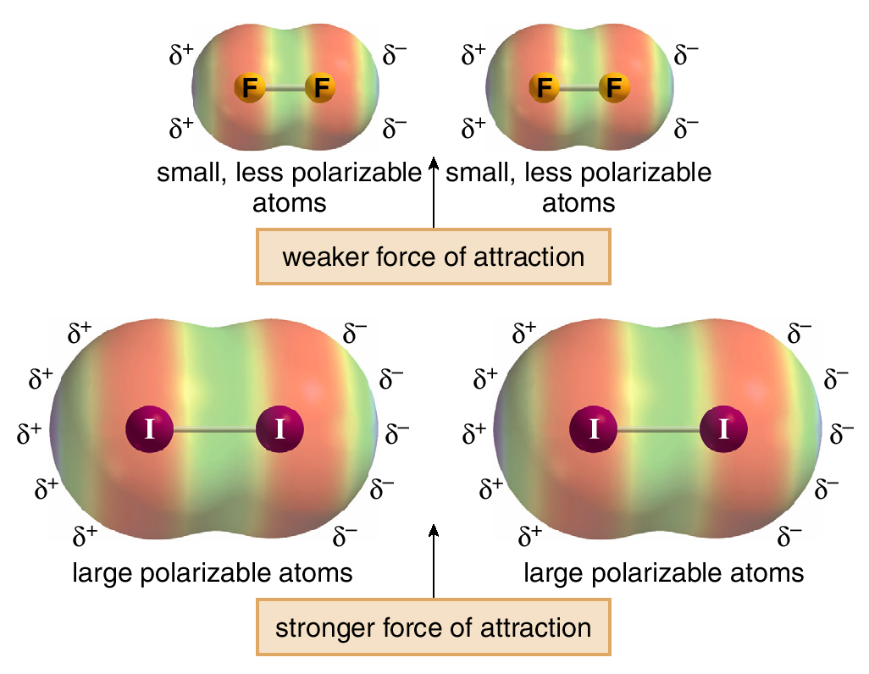
Dispersion forces
Dispersion forces are also affected by polarisability.
Polarisability is a measure of how the electron cloud around an atom responds to changes in its electronic environment.
Larger atoms, like iodine, which have more loosely held valence electrons, are more polarisable than smaller atoms like fluorine, which have more tightly held electrons. Thus, two F₂ molecules have little attractive force between them since the electrons are tightly held and temporary dipoles are difficult to induce.

Slide 14
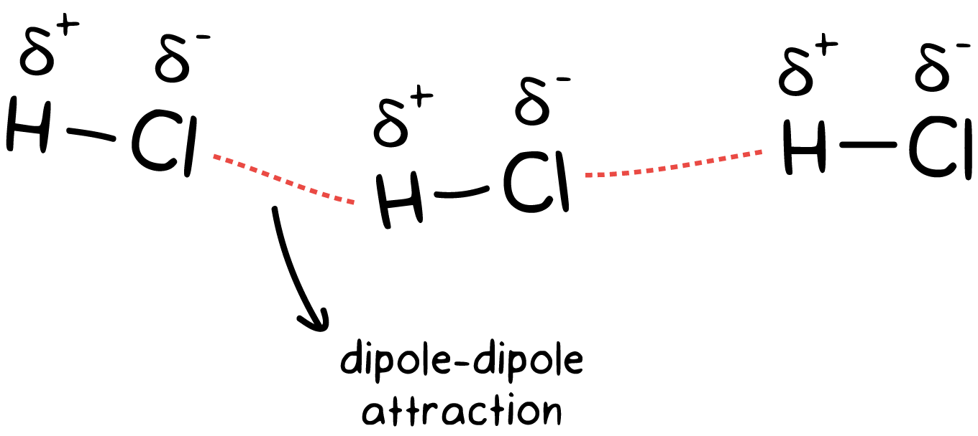
Dipole-Dipole forces
Polar molecules are able to attract one another due to the weak electrostatic attraction between their permanent dipoles
The dipoles in adjacent molecules align so that the partial positive and partial negative charges are in close proximity.

Slide 15
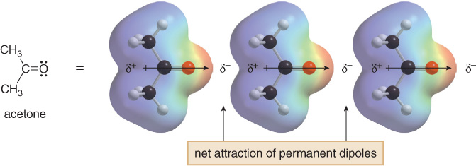
Dipole-Dipole forces
Consider acetone (propanone). The dipoles in adjacent molecules align so that the partial positive and partial negative charges are in close proximity. These attractive forces caused by permanent dipoles are much stronger than weaker dispersion forces.
Boiling point = 56 °C
Add acetone to your graph, what do you notice?

Slide 16
Boiling point vs number of carbons
Add in a point for acetone (propanone)
For same number of carbons it is significantly higher boiling point
If we compare based on molar mass – it still have a much higher boiling point
Dipole-dipole forces > dispersion forces

Slide 17
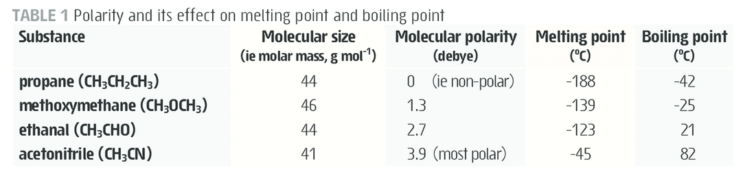
Dipole-Dipole forces
For molecules with similar molar mass, as the polarity increases the boiling point increases due to the increase strength of the dipole-dipole forces present
Remember – increased polarity means a stronger dipole is present. So the electrostatic attraction between molecules increases

Slide 18
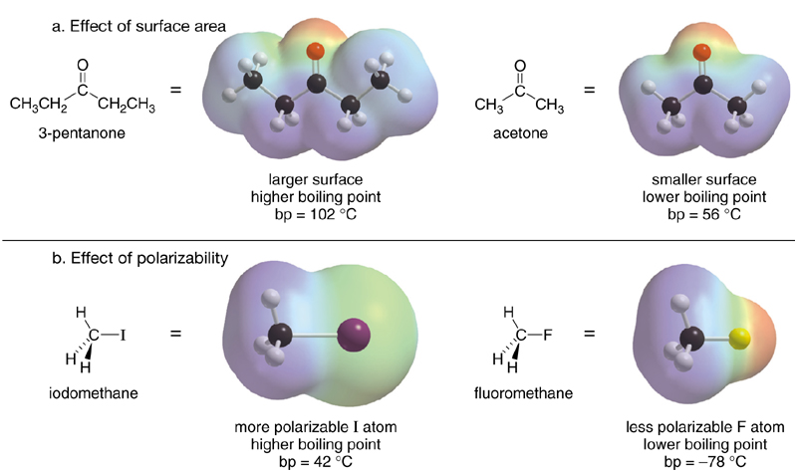
Dipole-Dipole forces
Consider the examples below which illustrate the effect of size and polarisability on boiling points.

Slide 19
Solubility
Solubility
Solubility refers to one substance dissolving another substance
For this to occur:
The forces of attraction between the molecules in substance A must break
The forces of attraction between the molecules in substance B must break
New forces of attraction must form between molecules of A and B
For this process to be energetically favourable the two substances need to have similar intermolecular forces present

Slide 20
Solubility
Solubility
Like dissolves Like
Substances that contain only dispersion forces will dissolves substances that only contain dispersion forces. For example, wax dissolves in non-polar solvents such as hexane, toluene or at home – cooking oil
Compounds with dipole-dipole forces dissolve other compounds containing dipole-dipole forces

Slide 21
Dipole-Dipole forces
Substances with dipole-dipole forces dissolve other compounds that also have dipole-dipole forces present
They can also dissolve ionic compounds, by forming ion-dipole interactions
Ion-dipole forces are attractive forces that are not classified as intermolecular forces

Slide 22
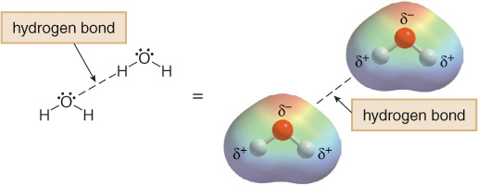
Hydrogen bonding
Hydrogen bonding typically occurs when a hydrogen atom bonded to O, N, or F forms an extreme polar bond.
Hydrogen bonds are directional intermolecular forces
The hydrogen’s positive dipole is electrostatically attracted to a lone pair of electrons on an O, N, or F atom in another molecule.

Slide 23
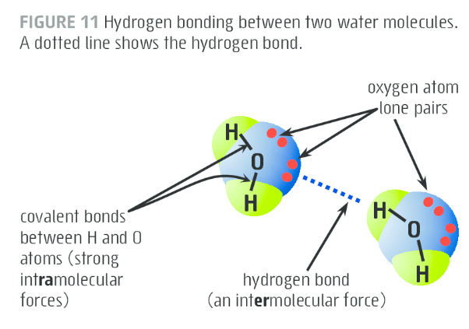
Hydrogen bonding
Hydrogen bonds are sometimes referred to as extreme dipole-dipole attraction
The strong hydrogen bonds have a big effect on physical properties (boiling point, melting point, solubility)

Slide 24
On going work
Pearson chapter 12.4

